Slide 1


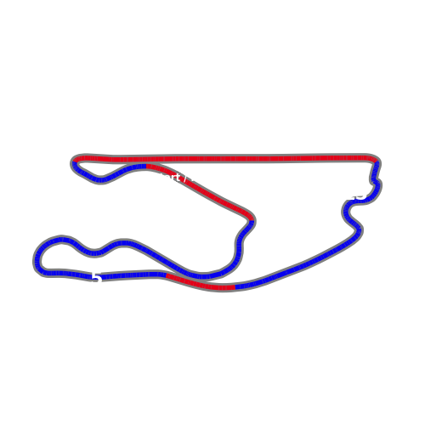
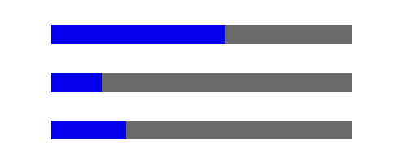

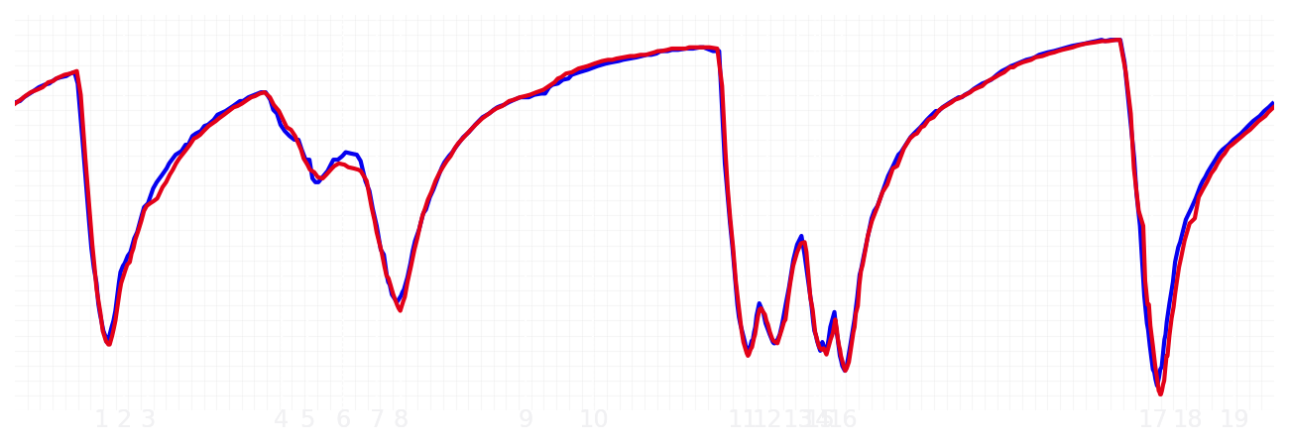
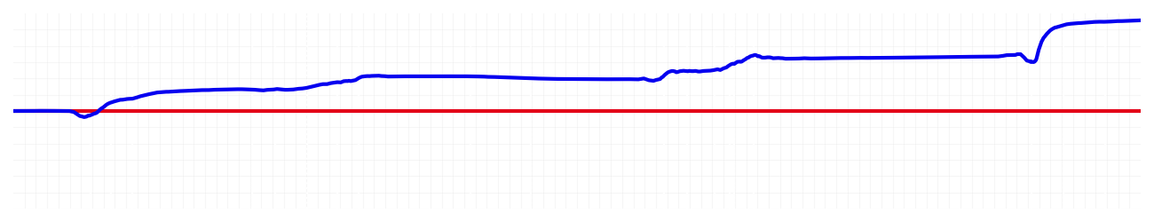
Miami GP Qualifying Q1
Driver
Max Verstappen
Yuki Tsunoda
Driver
Lap Time
01:27.953
01:29.246
Lap Time
Sector 1
29.191
Speed Trap 1
No Data
Speed Trap 1
No Data
Sector 1
29.622
Sector 2
33.569
Speed Trap 2
190 kp/h
Gap
-1.293
Gap
1.293
Speed Trap 2
190 kp/h
Sector 2
33.788
Sector 3
25.193
Speed Final Line
283 kp/h
Corner Advantage
3/20
Corner Advantage
17/20
Speed Final Line
282 kp/h
Sector 3
25.836
FULL THROTTLE
58%
55%
FULL THROTTLE
HEAVY BREAKING
17%
17%
HEAVY BREAKING
%LAP TIME
CORNERING
25%
28%
CORNERING
%LAP TIME
SPEED
SPEED
DELTA TIME
DELTA TIME

Slide 2

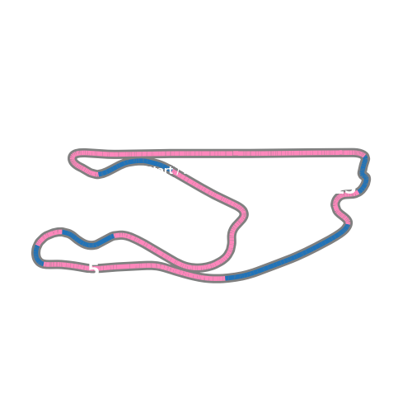


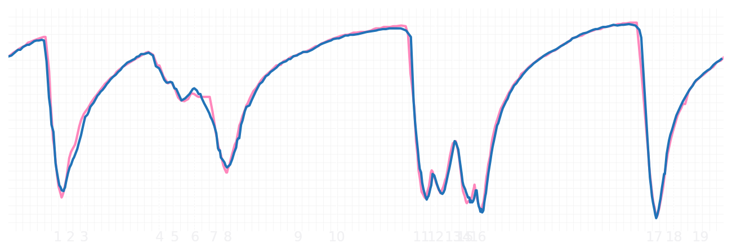
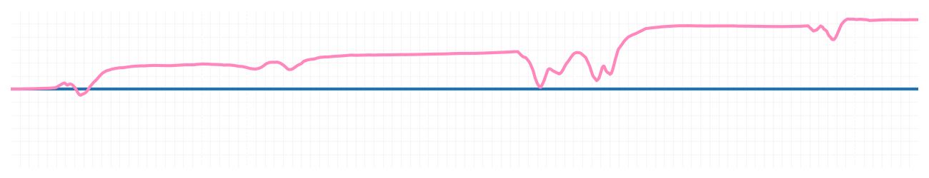
Miami GP Qualifying Q1
Driver
Pierre Gasly
Jack Doohan
Driver
Lap Time
01:28.345
01:29.171
Lap Time
Sector 1
29.237
Speed Trap 1
No Data
Speed Trap 1
No Data
Sector 1
29.756
Sector 2
33.838
Speed Trap 2
190 kp/h
Gap
-0.826
Gap
0.826
Speed Trap 2
187 kp/h
Sector 2
34.222
Sector 3
25.270
Speed Final Line
285 kp/h
Corner Advantage
8/20
Corner Advantage
12/20
Speed Final Line
285 kp/h
Sector 3
25.193
FULL THROTTLE
56%
56%
FULL THROTTLE
HEAVY BREAKING
17%
16%
HEAVY BREAKING
%LAP TIME
CORNERING
27%
28%
CORNERING
%LAP TIME
SPEED
SPEED
DELTA TIME
DELTA TIME

Slide 3

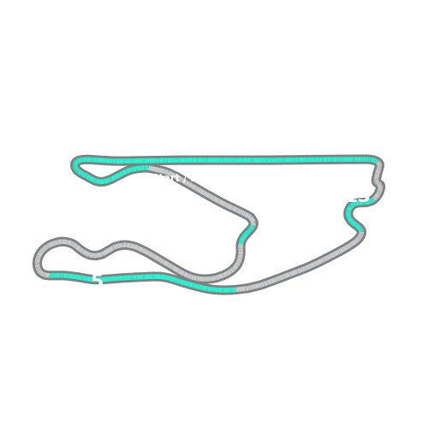


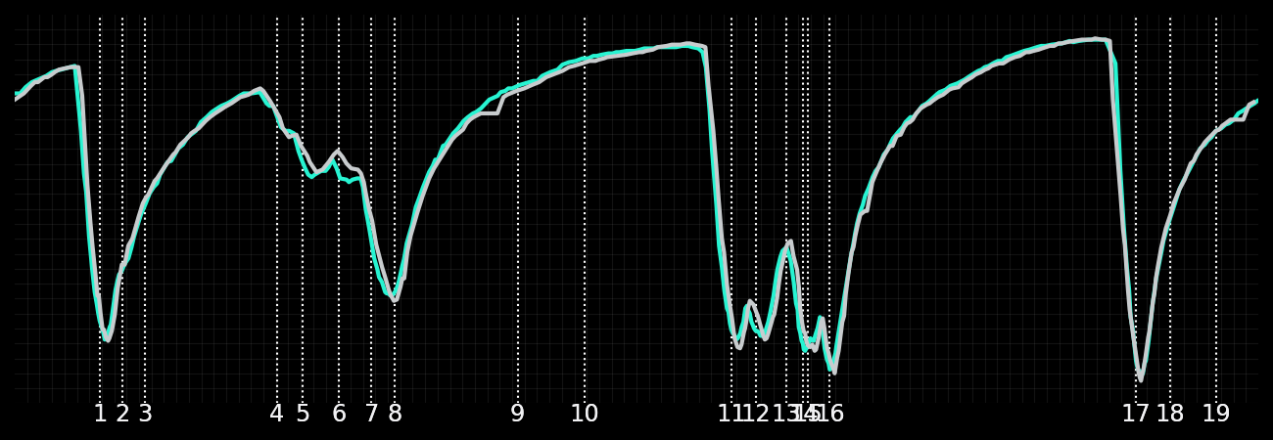
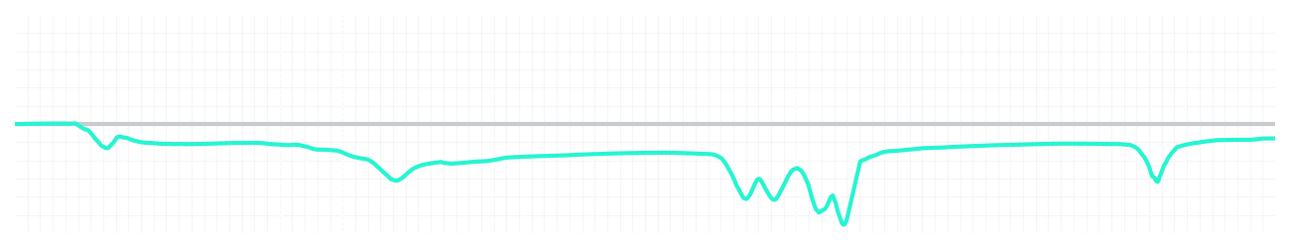
Miami GP Qualifying Q1
Driver
Kimi Antonelli
George Russell
Driver
Lap Time
01:27.858
01:27.688
Lap Time
Sector 1
29.393
Speed Trap 1
No Data
Speed Trap 1
No Data
Sector 1
29.087
Sector 2
33.542
Speed Trap 2
192 kp/h
Gap
0.17
Gap
-0.17
Speed Trap 2
191 kp/h
Sector 2
33.586
Sector 3
24.923
Speed Final Line
283 kp/h
Corner Advantage
11/20
Corner Advantage
9/20
Speed Final Line
285 kp/h
Sector 3
25.015
FULL THROTTLE
56%
60%
FULL THROTTLE
HEAVY BREAKING
16%
18%
HEAVY BREAKING
%LAP TIME
CORNERING
28%
22%
CORNERING
%LAP TIME
SPEED
SPEED
DELTA TIME
DELTA TIME

Slide 4

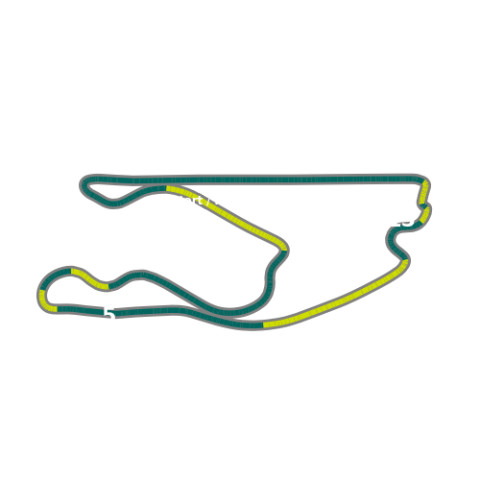


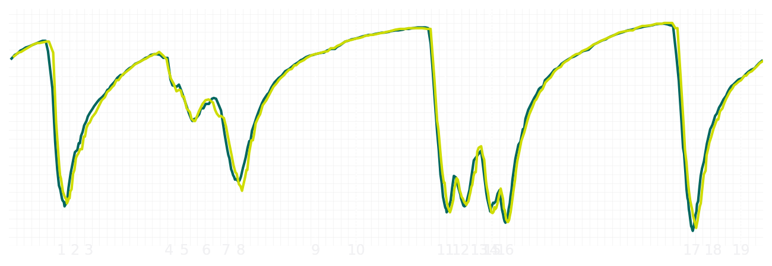
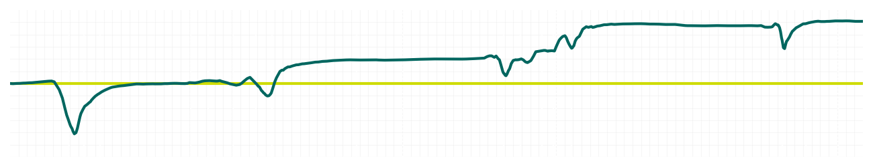
Miami GP Qualifying Q1
Driver
Fernando Alonso
Lance Stroll
Driver
Lap Time
01:28.455
01:29.028
Lap Time
Sector 1
29.483
Speed Trap 1
No Data
Speed Trap 1
No Data
Sector 1
29.750
Sector 2
33.820
Speed Trap 2
191 kp/h
Gap
-0.573
Gap
0.573
Speed Trap 2
189 kp/h
Sector 2
34.146
Sector 3
25.152
Speed Final Line
285 kp/h
Corner Advantage
7/20
Corner Advantage
13/20
Speed Final Line
286 kp/h
Sector 3
25.132
FULL THROTTLE
57%
56%
FULL THROTTLE
HEAVY BREAKING
18%
19%
HEAVY BREAKING
%LAP TIME
CORNERING
25%
25%
CORNERING
%LAP TIME
SPEED
SPEED
DELTA TIME
DELTA TIME

Slide 5

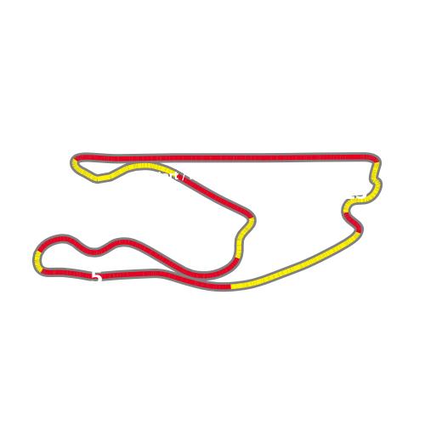


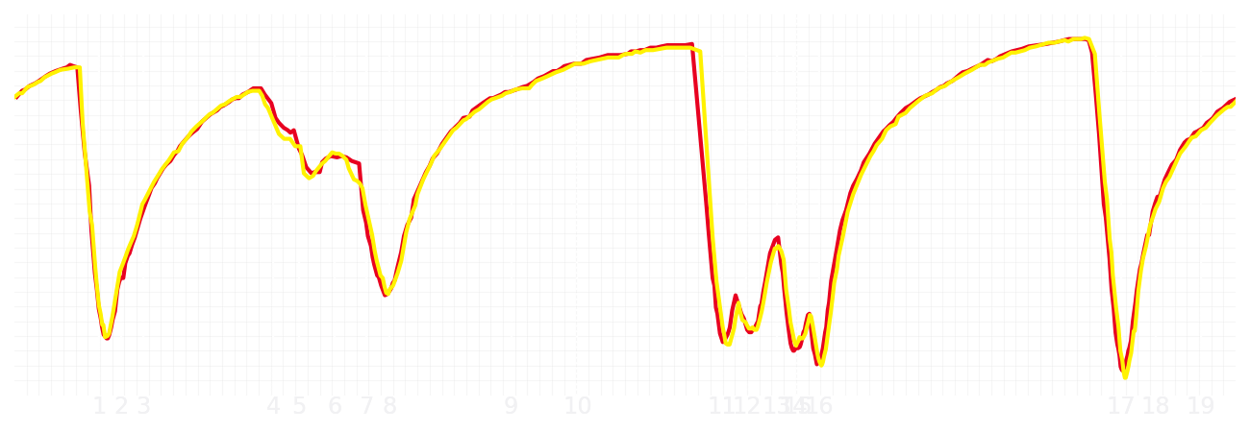
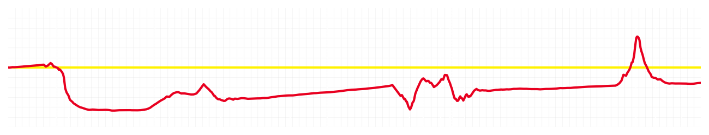
Miami GP Qualifying Q1
Driver
Charles Leclerc
Lewis Hamilton
Driver
Lap Time
01:28.325
01:28.231
Lap Time
Sector 1
29.444
Speed Trap 1
No Data
Speed Trap 1
No Data
Sector 1
29.309
Sector 2
33.783
Speed Trap 2
191 kp/h
Gap
0.094
Gap
-0.094
Speed Trap 2
189 kp/h
Sector 2
33.816
Sector 3
25.098
Speed Final Line
285 kp/h
Corner Advantage
10/20
Corner Advantage
10/20
Speed Final Line
285 kp/h
Sector 3
25.106
FULL THROTTLE
56%
57%
FULL THROTTLE
HEAVY BREAKING
16%
20%
HEAVY BREAKING
%LAP TIME
CORNERING
28%
23%
CORNERING
%LAP TIME
SPEED
SPEED
DELTA TIME
DELTA TIME

Slide 6

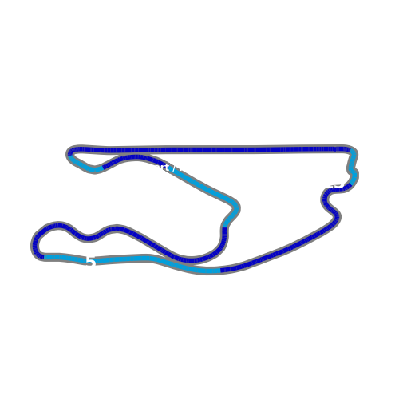

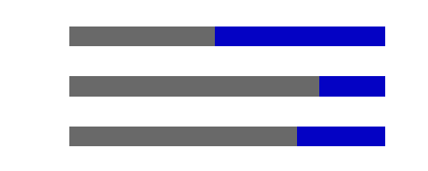
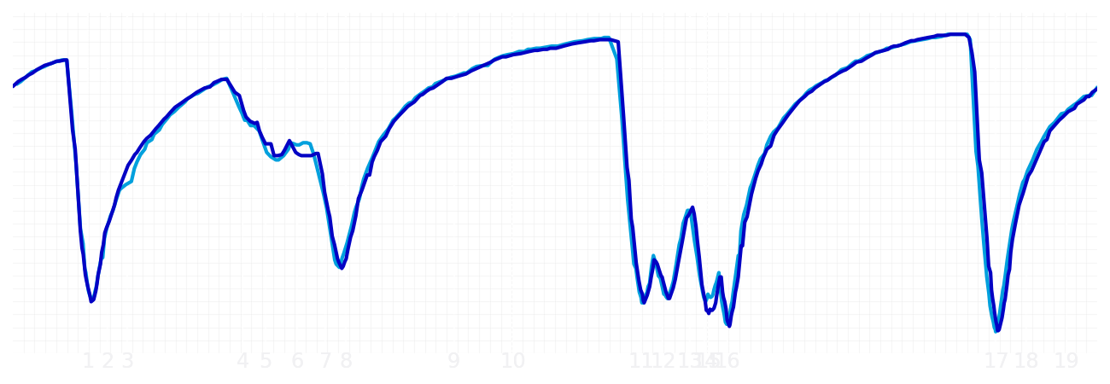
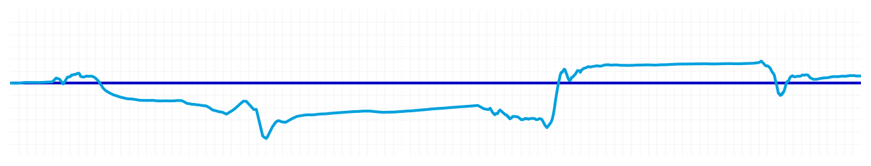
Miami GP Qualifying Q1
Driver
Alexander Albon
Carlos Sainz
Driver
Lap Time
01:27.859
01:27.899
Lap Time
Sector 1
29.421
Speed Trap 1
No Data
Speed Trap 1
No Data
Sector 1
29.274
Sector 2
33.470
Speed Trap 2
191 kp/h
Gap
-0.04
Gap
0.04
Speed Trap 2
191 kp/h
Sector 2
33.740
Sector 3
24.968
Speed Final Line
287 kp/h
Corner Advantage
11/20
Corner Advantage
9/20
Speed Final Line
287 kp/h
Sector 3
24.885
FULL THROTTLE
54%
54%
FULL THROTTLE
HEAVY BREAKING
18%
21%
HEAVY BREAKING
%LAP TIME
CORNERING
28%
25%
CORNERING
%LAP TIME
SPEED
SPEED
DELTA TIME
DELTA TIME

Slide 7

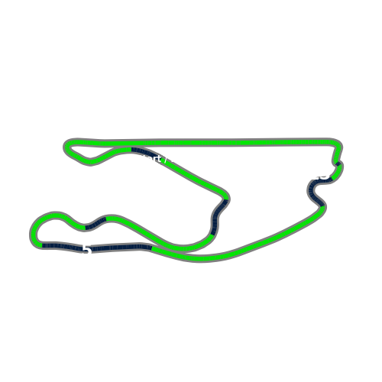


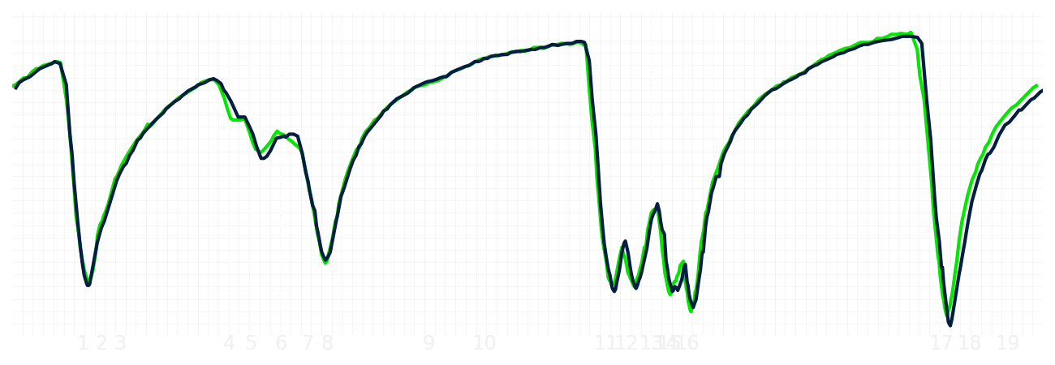
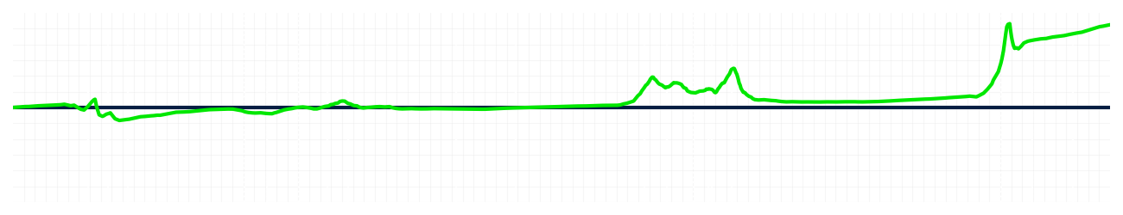
Miami GP Qualifying Q1
Driver
Nico Hulkenberg
Gabriel Bortoleto
Driver
Lap Time
01:28.542
01:29.312
Lap Time
Sector 1
29.445
Speed Trap 1
No Data
Speed Trap 1
No Data
Sector 1
29.487
Sector 2
33.929
Speed Trap 2
192 kp/h
Gap
-0.77
Gap
0.77
Speed Trap 2
192 kp/h
Sector 2
33.865
Sector 3
25.168
Speed Final Line
293 kp/h
Corner Advantage
7/20
Corner Advantage
13/20
Speed Final Line
285 kp/h
Sector 3
25.960
FULL THROTTLE
54%
57%
FULL THROTTLE
HEAVY BREAKING
20%
20%
HEAVY BREAKING
%LAP TIME
CORNERING
26%
23%
CORNERING
%LAP TIME
SPEED
SPEED
DELTA TIME
DELTA TIME

Slide 8

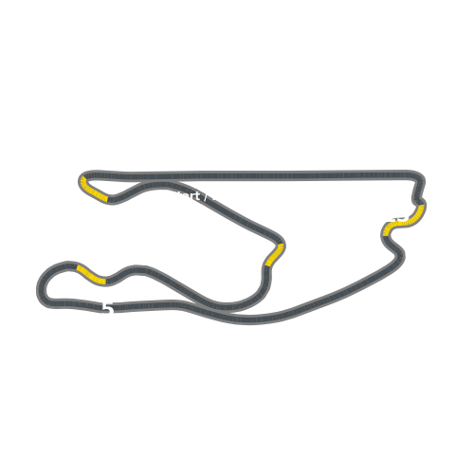


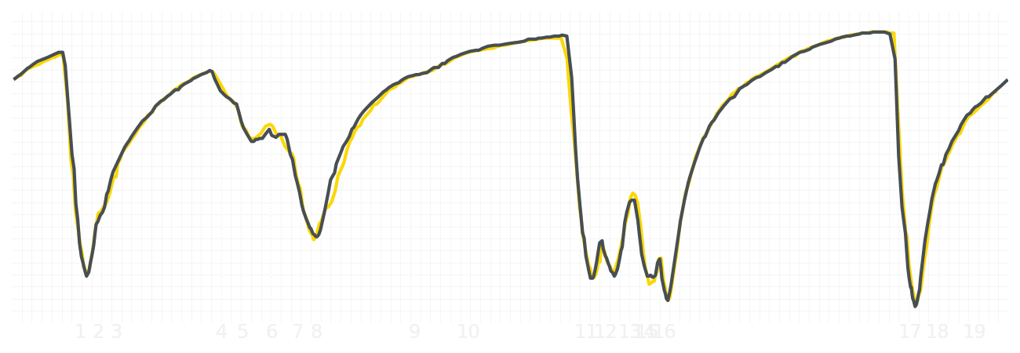
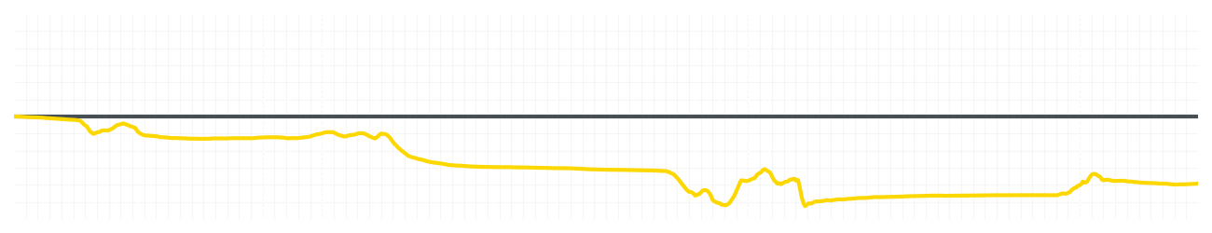
Miami GP Qualifying Q1
Driver
Liam Lawson
Isack Hadjar
Driver
Lap Time
01:28.914
01:28.394
Lap Time
Sector 1
29.615
Speed Trap 1
No Data
Speed Trap 1
No Data
Sector 1
29.310
Sector 2
34.001
Speed Trap 2
189 kp/h
Gap
0.52
Gap
-0.52
Speed Trap 2
189 kp/h
Sector 2
33.766
Sector 3
25.298
Speed Final Line
283 kp/h
Corner Advantage
15/20
Corner Advantage
5/20
Speed Final Line
284 kp/h
Sector 3
25.318
FULL THROTTLE
56%
57%
FULL THROTTLE
HEAVY BREAKING
16%
17%
HEAVY BREAKING
%LAP TIME
CORNERING
28%
26%
CORNERING
%LAP TIME
SPEED
SPEED
DELTA TIME
DELTA TIME

Slide 9

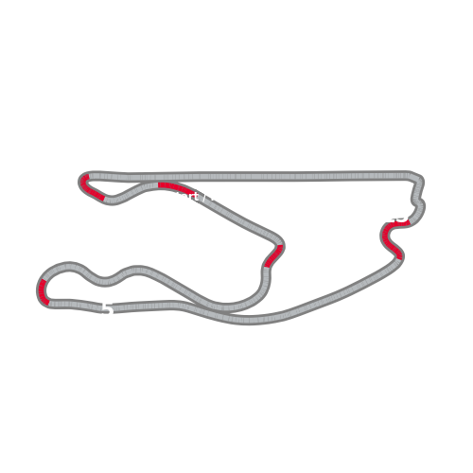


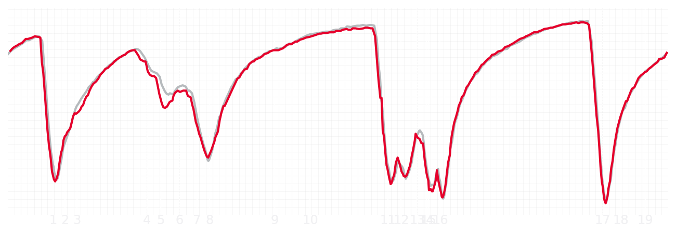
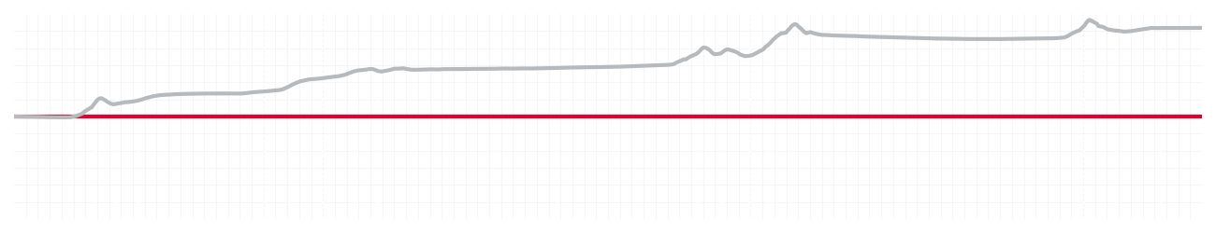
Miami GP Qualifying Q1
Driver
Esteban Ocon
Oliver Bearman
Driver
Lap Time
01:28.303
01:29.825
Lap Time
Sector 1
29.329
Speed Trap 1
No Data
Speed Trap 1
No Data
Sector 1
30.124
Sector 2
33.829
Speed Trap 2
192 kp/h
Gap
-1.522
Gap
1.522
Speed Trap 2
191 kp/h
Sector 2
34.423
Sector 3
25.145
Speed Final Line
285 kp/h
Corner Advantage
5/20
Corner Advantage
15/20
Speed Final Line
283 kp/h
Sector 3
25.278
FULL THROTTLE
56%
55%
FULL THROTTLE
HEAVY BREAKING
22%
22%
HEAVY BREAKING
%LAP TIME
CORNERING
22%
23%
CORNERING
%LAP TIME
SPEED
SPEED
DELTA TIME
DELTA TIME

Slide 10

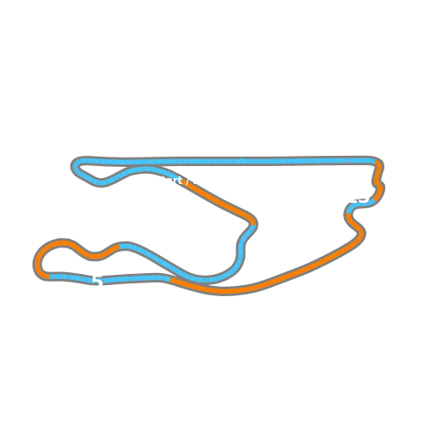


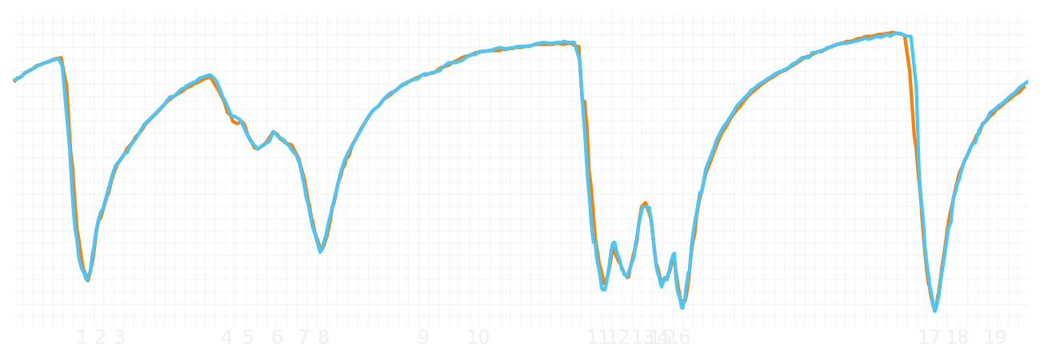
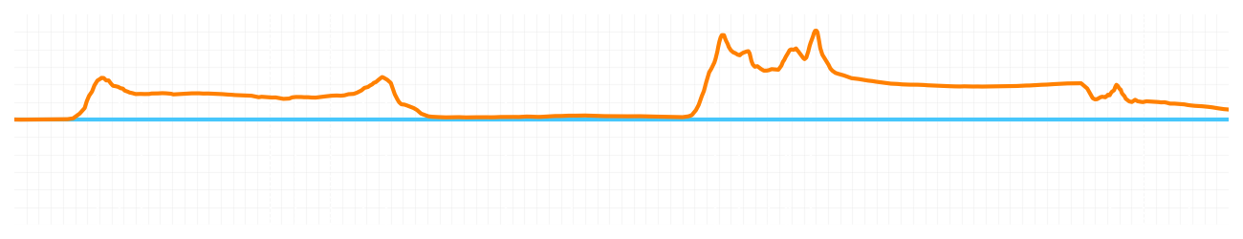
Miami GP Qualifying Q1
Driver
Lando Norris
Oscar Piastri
Driver
Lap Time
01:27.890
01:27.951
Lap Time
Sector 1
29.312
Speed Trap 1
No Data
Speed Trap 1
No Data
Sector 1
29.400
Sector 2
33.521
Speed Trap 2
188 kp/h
Gap
-0.061
Gap
0.061
Speed Trap 2
191 kp/h
Sector 2
33.610
Sector 3
25.057
Speed Final Line
284 kp/h
Corner Advantage
9/20
Corner Advantage
11/20
Speed Final Line
288 kp/h
Sector 3
24.941
FULL THROTTLE
56%
55%
FULL THROTTLE
HEAVY BREAKING
17%
18%
HEAVY BREAKING
%LAP TIME
CORNERING
27%
27%
CORNERING
%LAP TIME
SPEED
SPEED
DELTA TIME
DELTA TIME

Slide 11
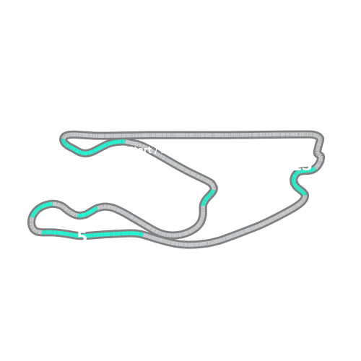


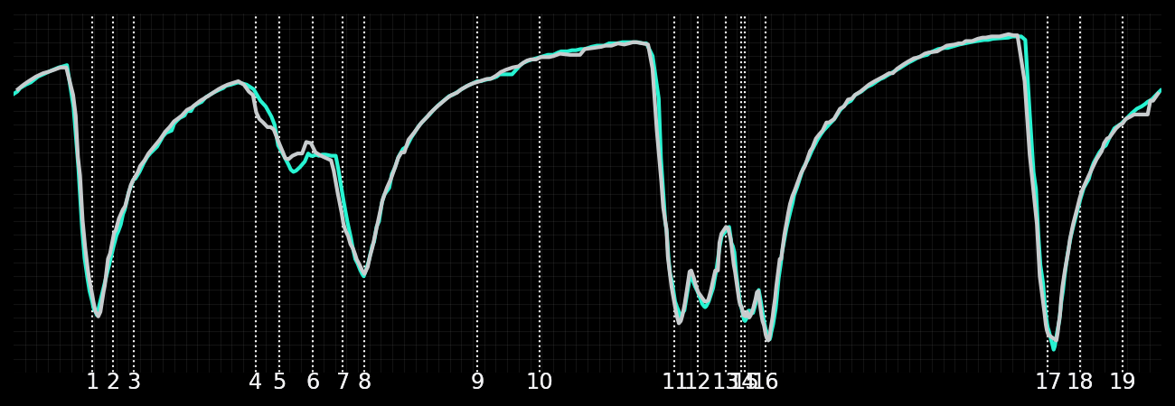
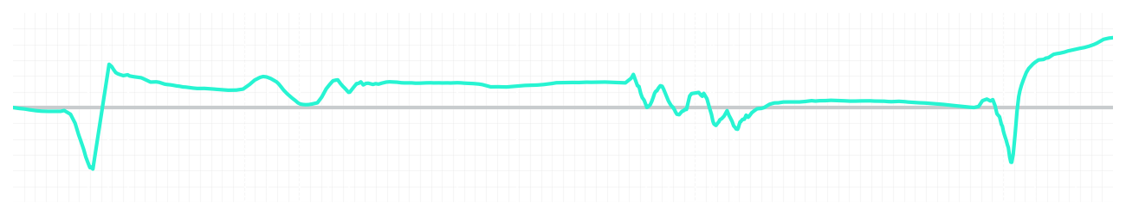
Miami GP Qualifying Q2
Driver
Kimi Antonelli
George Russell
Driver
Lap Time
01:27.384
01:27.666
Lap Time
Sector 1
29.056
Speed Trap 1
No Data
Speed Trap 1
No Data
Sector 1
29.100
Sector 2
33.309
Speed Trap 2
192 kp/h
Gap
-0.282
Gap
0.282
Speed Trap 2
192 kp/h
Sector 2
33.271
Sector 3
25.019
Speed Final Line
286 kp/h
Corner Advantage
11/20
Corner Advantage
9/20
Speed Final Line
284 kp/h
Sector 3
25.295
FULL THROTTLE
58%
57%
FULL THROTTLE
HEAVY BREAKING
17%
18%
HEAVY BREAKING
%LAP TIME
CORNERING
25%
25%
CORNERING
%LAP TIME
SPEED
SPEED
DELTA TIME
DELTA TIME

Slide 12
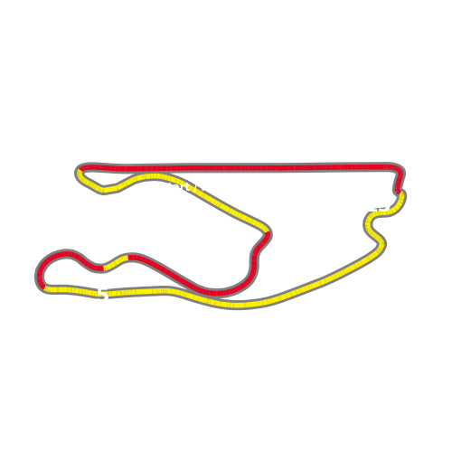


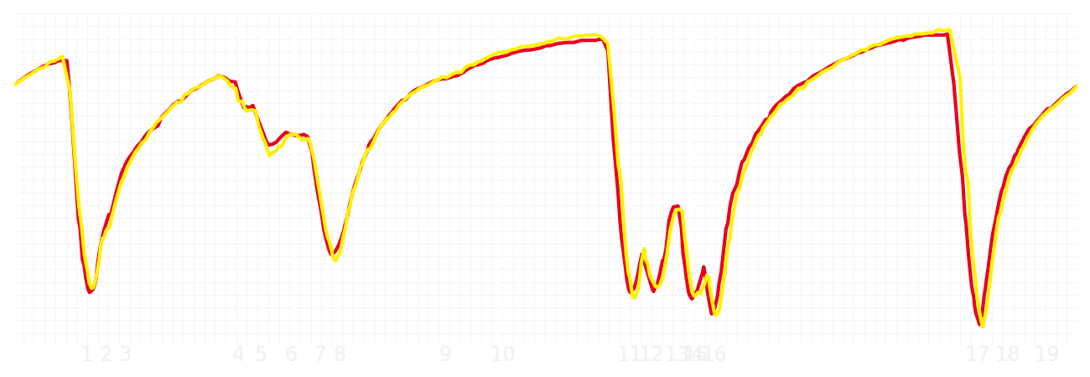
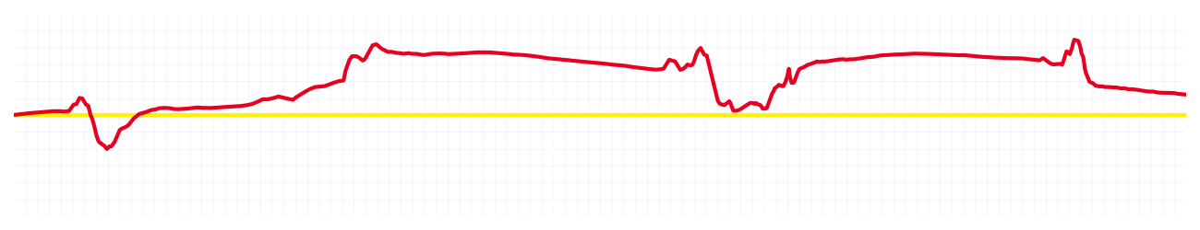
Miami GP Qualifying Q2
Driver
Charles Leclerc
Lewis Hamilton
Driver
Lap Time
01:27.467
01:27.546
Lap Time
Sector 1
29.043
Speed Trap 1
No Data
Speed Trap 1
No Data
Sector 1
29.190
Sector 2
33.309
Speed Trap 2
192 kp/h
Gap
-0.079
Gap
0.079
Speed Trap 2
190 kp/h
Sector 2
33.403
Sector 3
25.115
Speed Final Line
284 kp/h
Corner Advantage
12/20
Corner Advantage
8/20
Speed Final Line
287 kp/h
Sector 3
24.953
FULL THROTTLE
62%
60%
FULL THROTTLE
HEAVY BREAKING
15%
19%
HEAVY BREAKING
%LAP TIME
CORNERING
23%
21%
CORNERING
%LAP TIME
SPEED
SPEED
DELTA TIME
DELTA TIME

Slide 13
Miami GP Qualifying Q2

Slide 14
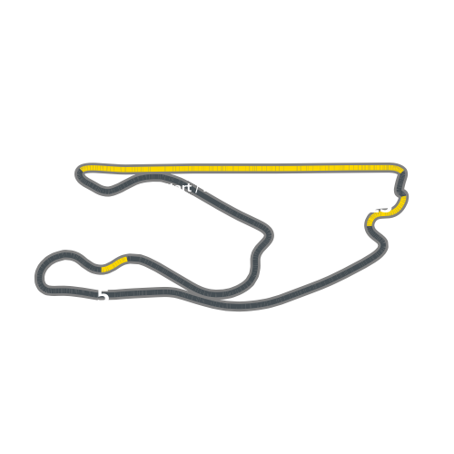


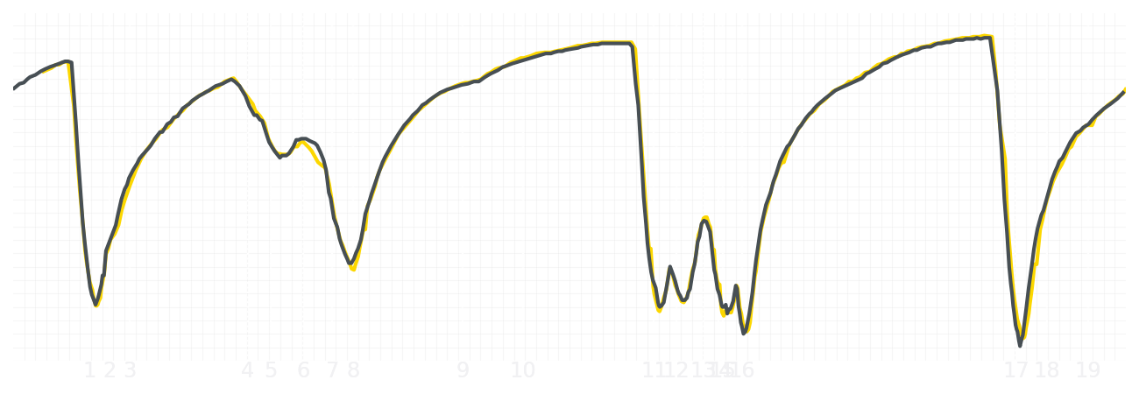
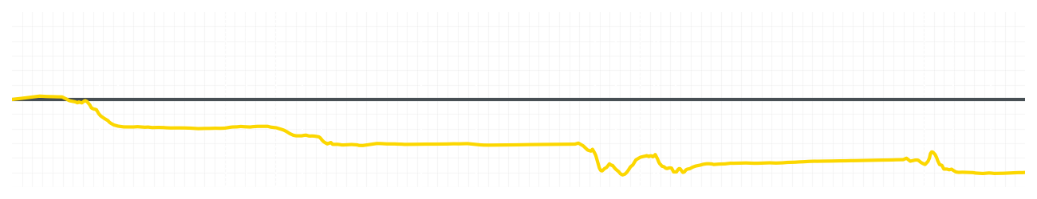
Miami GP Qualifying Q2
Driver
Liam Lawson
Isack Hadjar
Driver
Lap Time
01:28.375
01:27.773
Lap Time
Sector 1
29.420
Speed Trap 1
No Data
Speed Trap 1
No Data
Sector 1
29.016
Sector 2
33.599
Speed Trap 2
190 kp/h
Gap
0.602
Gap
-0.602
Speed Trap 2
190 kp/h
Sector 2
33.498
Sector 3
25.356
Speed Final Line
284 kp/h
Corner Advantage
15/20
Corner Advantage
5/20
Speed Final Line
282 kp/h
Sector 3
25.259
FULL THROTTLE
57%
57%
FULL THROTTLE
HEAVY BREAKING
18%
17%
HEAVY BREAKING
%LAP TIME
CORNERING
25%
26%
CORNERING
%LAP TIME
SPEED
SPEED
DELTA TIME
DELTA TIME

Slide 15
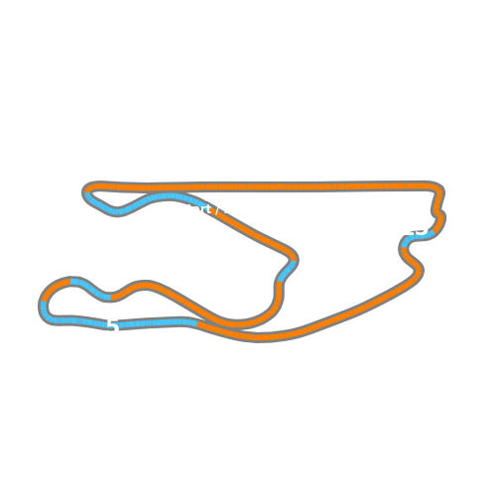

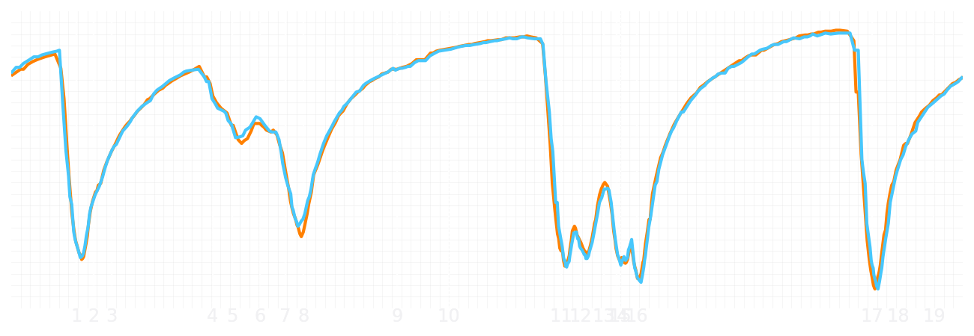
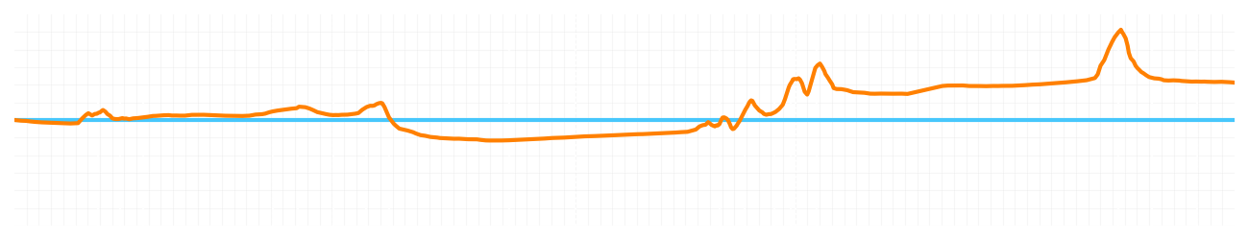
Miami GP Qualifying Q2
Driver
Lando Norris
Oscar Piastri
Driver
Lap Time
01:27.109
01:27.354
Lap Time
Sector 1
29.162
Speed Trap 1
No Data
Speed Trap 1
No Data
Sector 1
28.995
Sector 2
33.115
Speed Trap 2
192 kp/h
Gap
-0.245
Gap
0.245
Speed Trap 2
191 kp/h
Sector 2
33.405
Sector 3
24.832
Speed Final Line
286 kp/h
Corner Advantage
8/20
Corner Advantage
12/20
Speed Final Line
286 kp/h
Sector 3
24.954
FULL THROTTLE
57%
55%
FULL THROTTLE
HEAVY BREAKING
16%
18%
HEAVY BREAKING
%LAP TIME
CORNERING
27%
27%
CORNERING
%LAP TIME
SPEED
SPEED
DELTA TIME
DELTA TIME

Slide 16
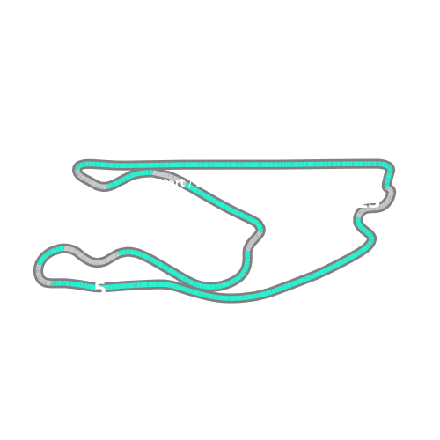


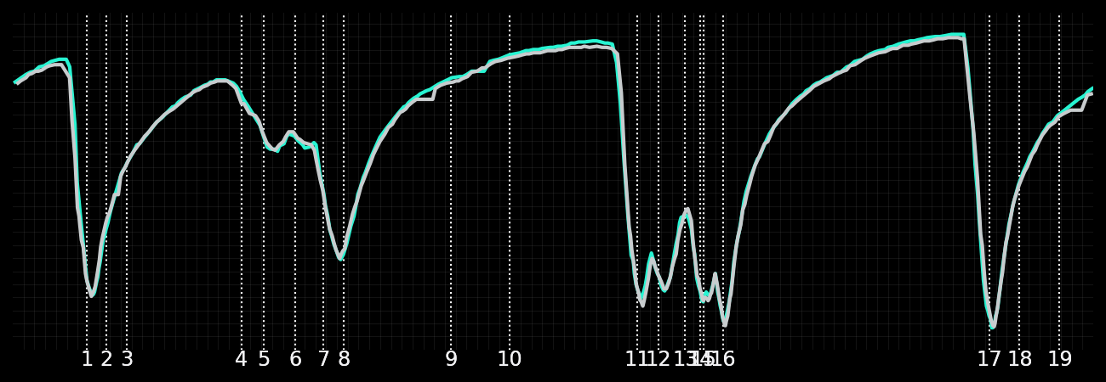
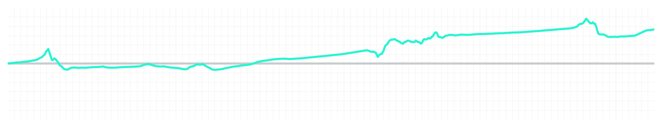
Miami GP Qualifying Q3
Driver
Kimi Antonelli
George Russell
Driver
Lap Time
01:26.482
01:26.791
Lap Time
Sector 1
28.668
Speed Trap 1
No Data
Speed Trap 1
No Data
Sector 1
28.678
Sector 2
32.978
Speed Trap 2
193 kp/h
Gap
-0.309
Gap
0.309
Speed Trap 2
193 kp/h
Sector 2
33.266
Sector 3
24.836
Speed Final Line
286 kp/h
Corner Advantage
8/20
Corner Advantage
12/20
Speed Final Line
283 kp/h
Sector 3
24.847
FULL THROTTLE
59%
59%
FULL THROTTLE
HEAVY BREAKING
14%
16%
HEAVY BREAKING
%LAP TIME
CORNERING
27%
25%
CORNERING
%LAP TIME
SPEED
SPEED
DELTA TIME
DELTA TIME

Slide 17
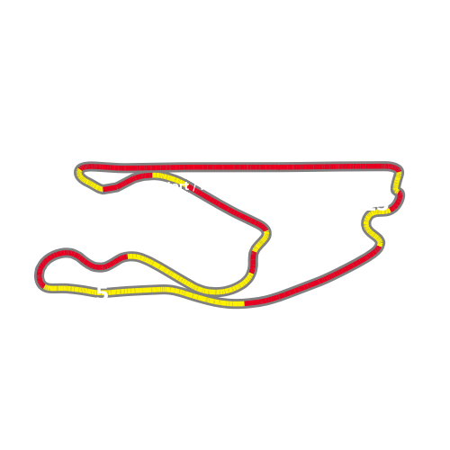


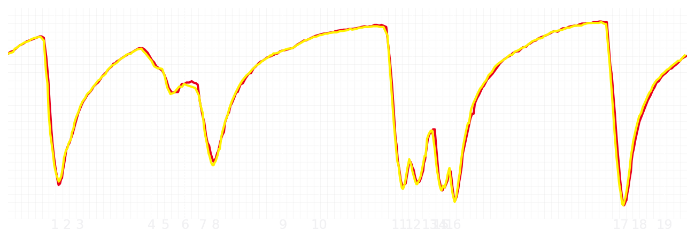
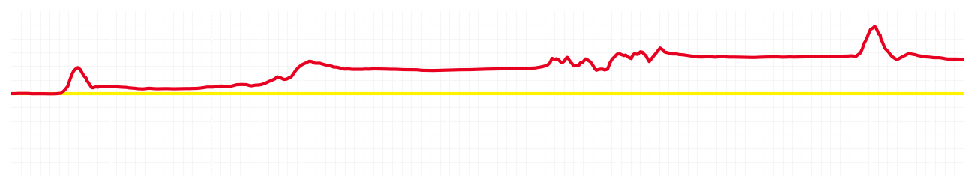
Miami GP Qualifying Q3
Driver
Charles Leclerc
Lewis Hamilton
Driver
Lap Time
01:26.808
01:27.030
Lap Time
Sector 1
28.756
Speed Trap 1
No Data
Speed Trap 1
No Data
Sector 1
28.912
Sector 2
33.107
Speed Trap 2
192 kp/h
Gap
-0.222
Gap
0.222
Speed Trap 2
194 kp/h
Sector 2
33.178
Sector 3
24.945
Speed Final Line
285 kp/h
Corner Advantage
9/20
Corner Advantage
11/20
Speed Final Line
285 kp/h
Sector 3
24.940
FULL THROTTLE
58%
62%
FULL THROTTLE
HEAVY BREAKING
18%
20%
HEAVY BREAKING
%LAP TIME
CORNERING
24%
18%
CORNERING
%LAP TIME
SPEED
SPEED
DELTA TIME
DELTA TIME

Slide 18





Miami GP Qualifying Q3
Driver
Lando Norris
Oscar Piastri
Driver
Lap Time
01:26.582
01:26.527
Lap Time
Sector 1
28.740
Speed Trap 1
No Data
Speed Trap 1
No Data
Sector 1
28.648
Sector 2
32.990
Speed Trap 2
191 kp/h
Gap
0.055
Gap
-0.055
Speed Trap 2
193 kp/h
Sector 2
32.936
Sector 3
24.852
Speed Final Line
285 kp/h
Corner Advantage
11/20
Corner Advantage
9/20
Speed Final Line
286 kp/h
Sector 3
24.943
FULL THROTTLE
59%
59%
FULL THROTTLE
HEAVY BREAKING
15%
17%
HEAVY BREAKING
%LAP TIME
CORNERING
26%
24%
CORNERING
%LAP TIME
SPEED
SPEED
DELTA TIME
DELTA TIME

